Slide 1

HEALTH CARE SYSTEM
Developed By:
Alok Pattanaik
Pratik Prakash
Shaik Reshma
Golla Yashaswini Uradi Bhavani
Mentored by:
Javeed Mohammed Husnuddin

Slide 2
Contents
Abstract
MVC Architecture
UML Diagrams
Requirement Specification
Modules
Result

Slide 3

ABSTRACT
The system consists of various diagnostic centers, with their own tests which the customers can opt for. The system should be accessible to two types of users, namely admin and customer. Admin has control over adding, removing and updating diagnostic centers and the tests under them.
Customer makes an appointment after selecting a proper date-time as well as the test and diagnostic center. The appointment will be confirmed only after the admin approves it.
Health Care System

Slide 4
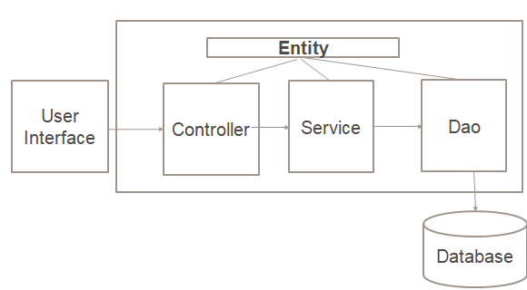
MVC Architecture
OUR HEALTHCARE CENTER

Slide 5
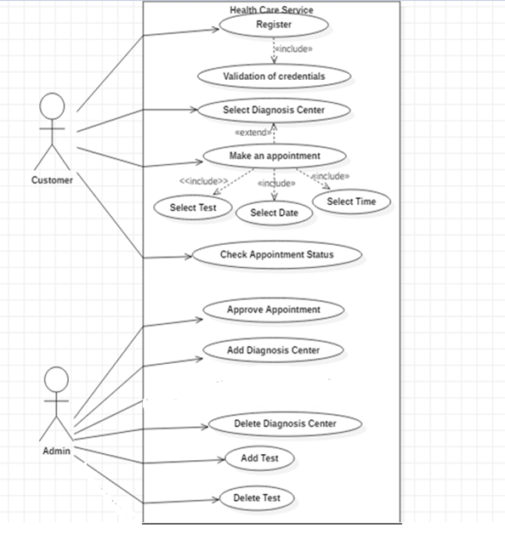
Use case Diagram
OUR HEALTHCARE CENTER

Slide 6
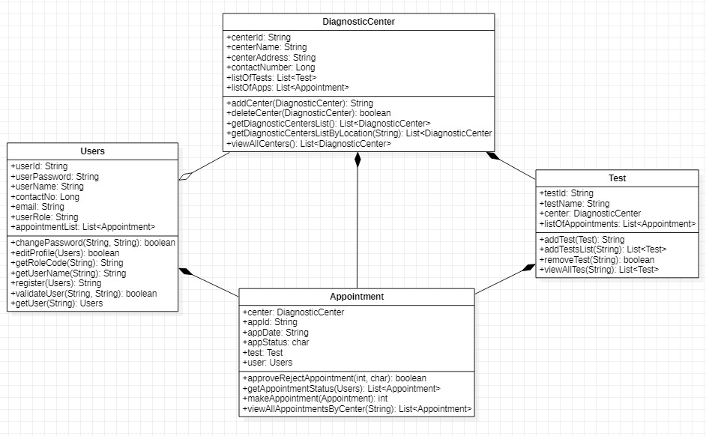
Class Diagram
OUR HEALTHCARE CENTER

Slide 7
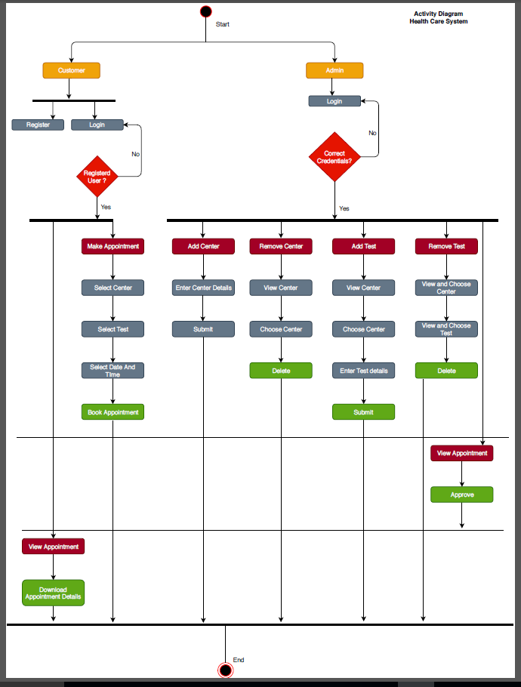
Activity Diagram
OUR HEALTHCARE CENTER

Slide 8
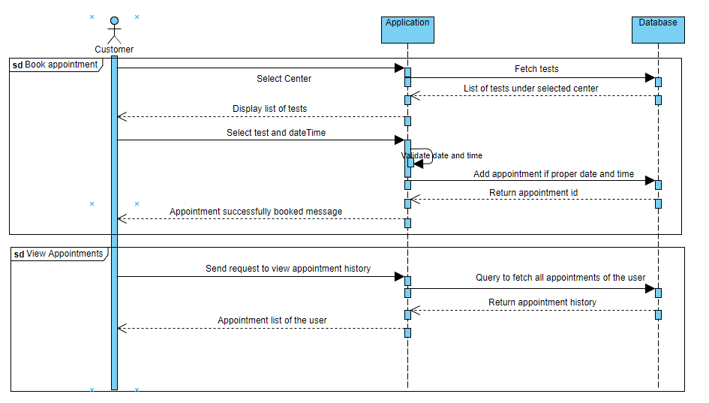
Sequence Diagram - User
OUR HEALTHCARE CENTER

Slide 9
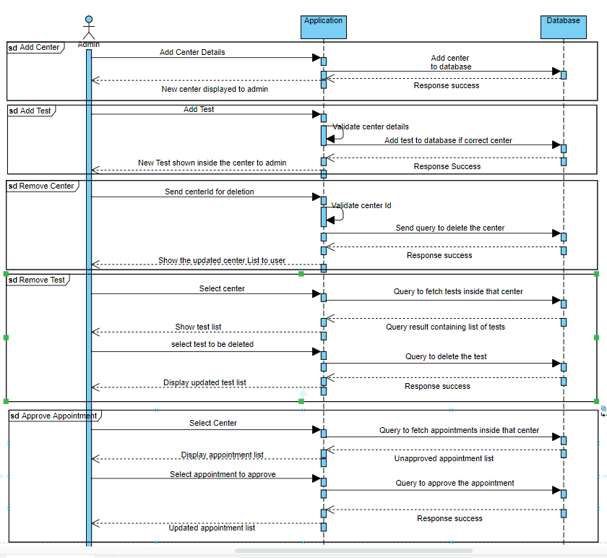
Sequence Diagram - Admin
OUR HEALTHCARE CENTER

Slide 10

Requirement Specification
Software Requirement:
Operating system: Windows 7/XP/8.0/8.1/10.
IDE: Eclipse IDE
Backend: Java
Frontend: JSP, CSS, HTML
Database: Oracle database
Server: Apache Tomcat server
Hardware Requirement:
System: 2GB ram 64bit processor
Hard Disk: 80 GB.
Keyboard: 101 Keys

Slide 11

Modules
Login Module
Admin Module
User Module

Slide 12

Login Module
Admin can login to the portal with his/her credentials.
User can register and login to the portal with valid credentials.

Slide 13
Admin Module
Can create a new center.
Can delete an existing center.
Can add test under a particular center.
Remove test under a particular center.
Approve/Reject the appointments made by the user.

Slide 14
User Module
User can make an appointment under a particular center for the available tests.
User can choose the center based on the locations.
User can check the status of their respective booked appointments.

Slide 15
Sub Modules
Diagnostic Center
Test
Make Appointment
Approve/Reject Appointment
Check Appointment Status

Slide 16
Diagnostic Center
Admin can register a diagnostic center with its details.
By default 3 tests will be available at all centers.
Blood test
Blood sugar
Blood pressure
Admin can also delete a center.

Slide 17
Test
Admin can add any number of tests under a particular center.
Admin can also remove any test under a particular center.

Slide 18
Make Appointment
User can select any center from the available centers based on location.
User can choose a test under the selected center.
He/She has to choose appropriate date and time in order to book an appointment.

Slide 19
Approve Appointment
Admin can approve or reject the appointments under a center.

Slide 20
Check Appointment Status
User can check the status of their respective appointment.

Slide 21
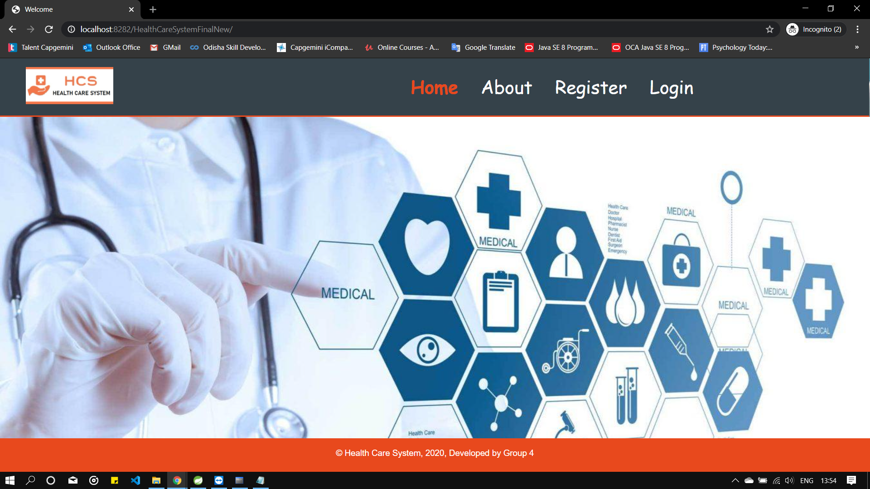

Slide 22
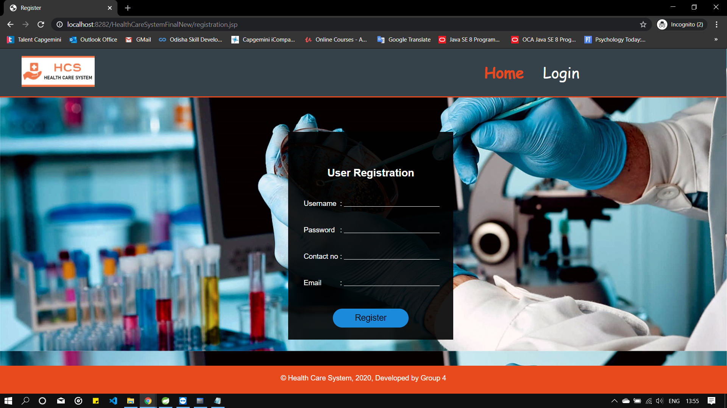

Slide 23
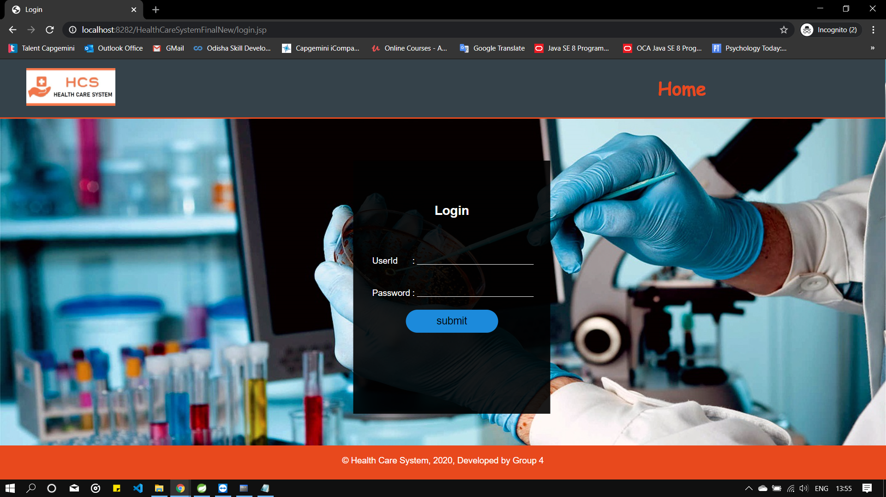

Slide 24
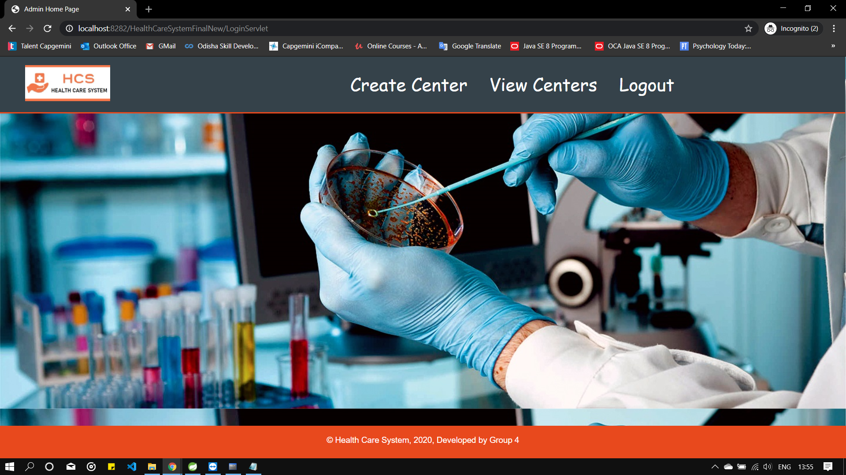

Slide 25
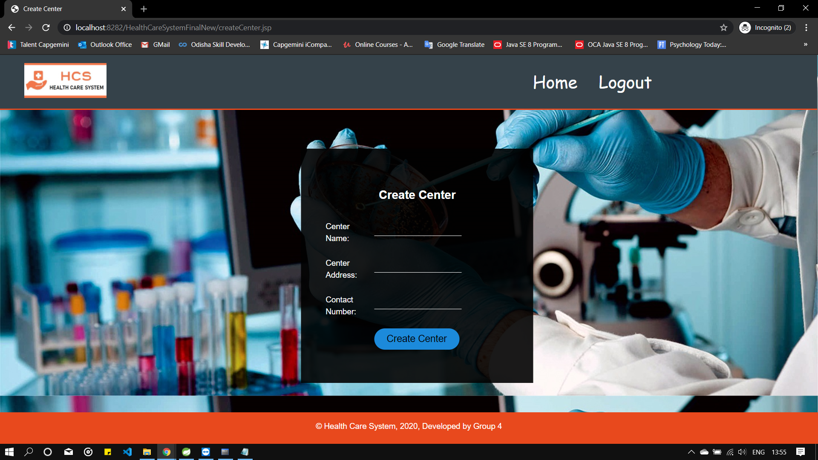

Slide 26
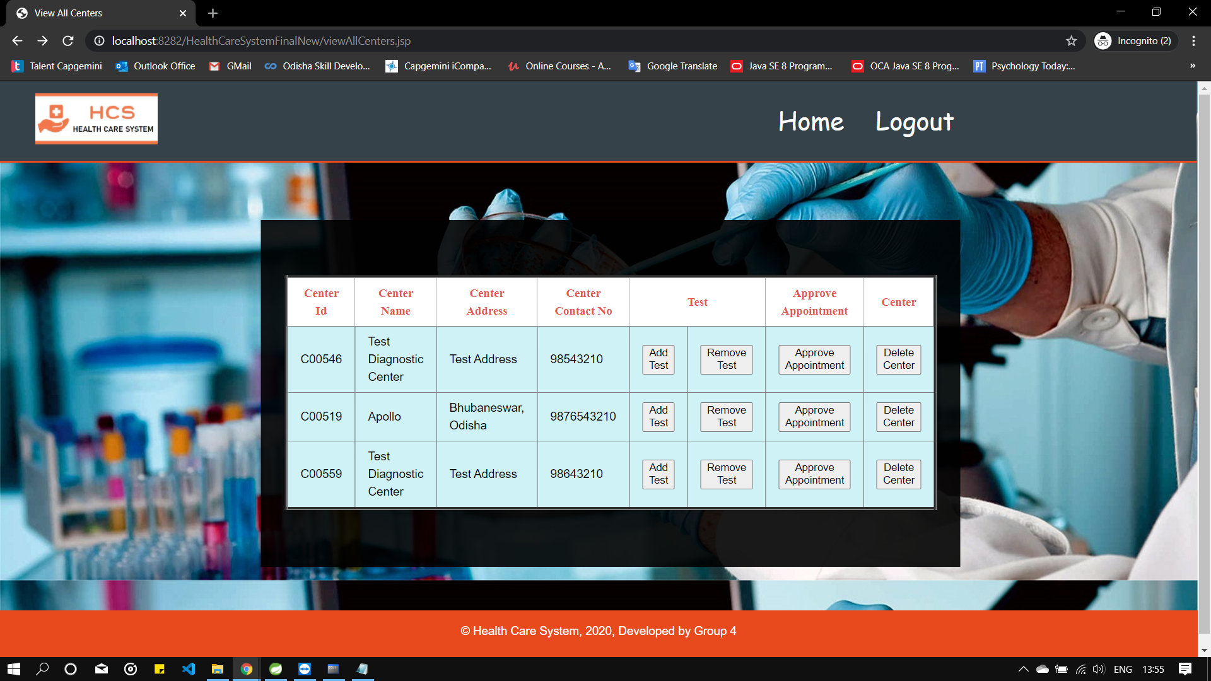

Slide 27
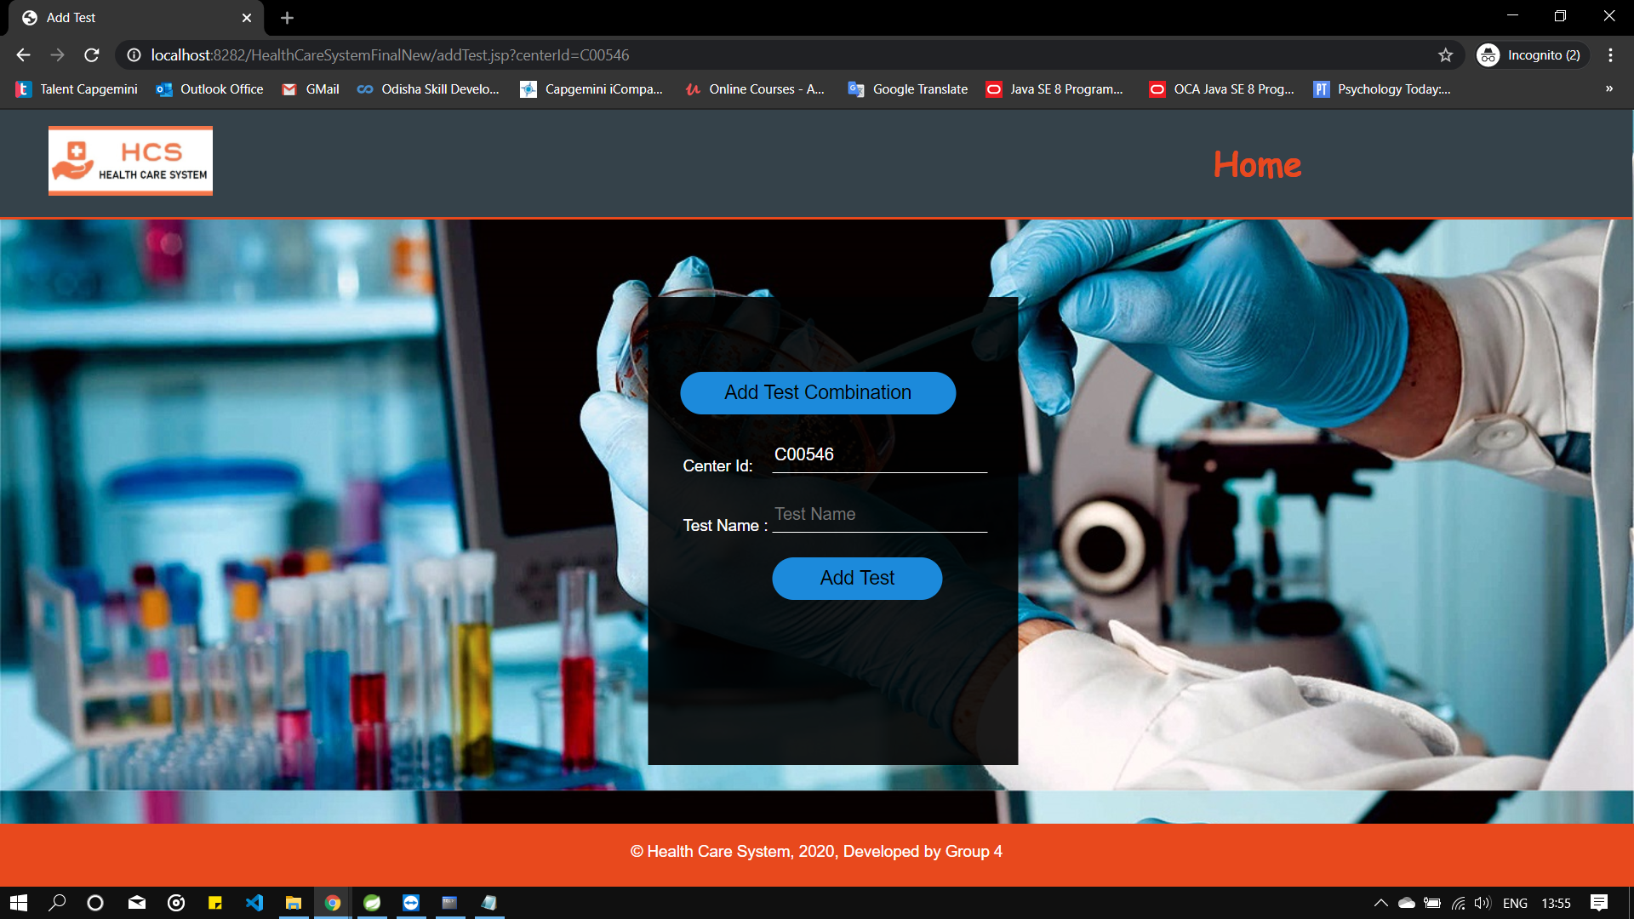

Slide 28
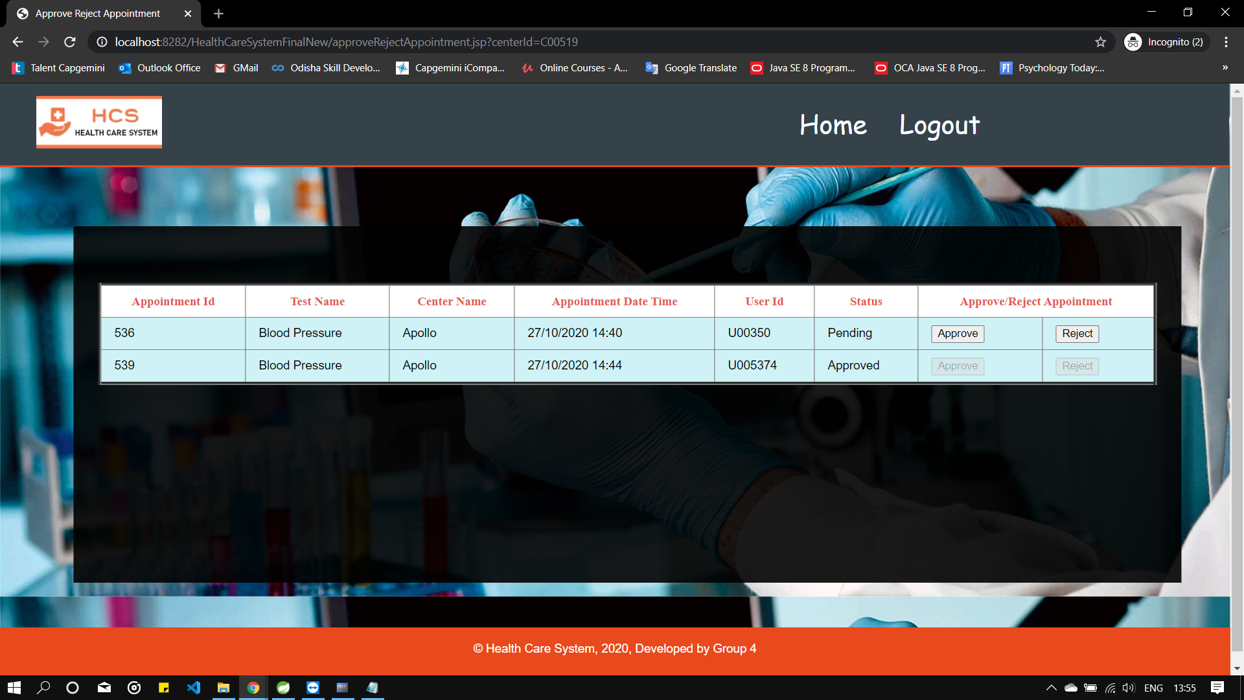

Slide 29
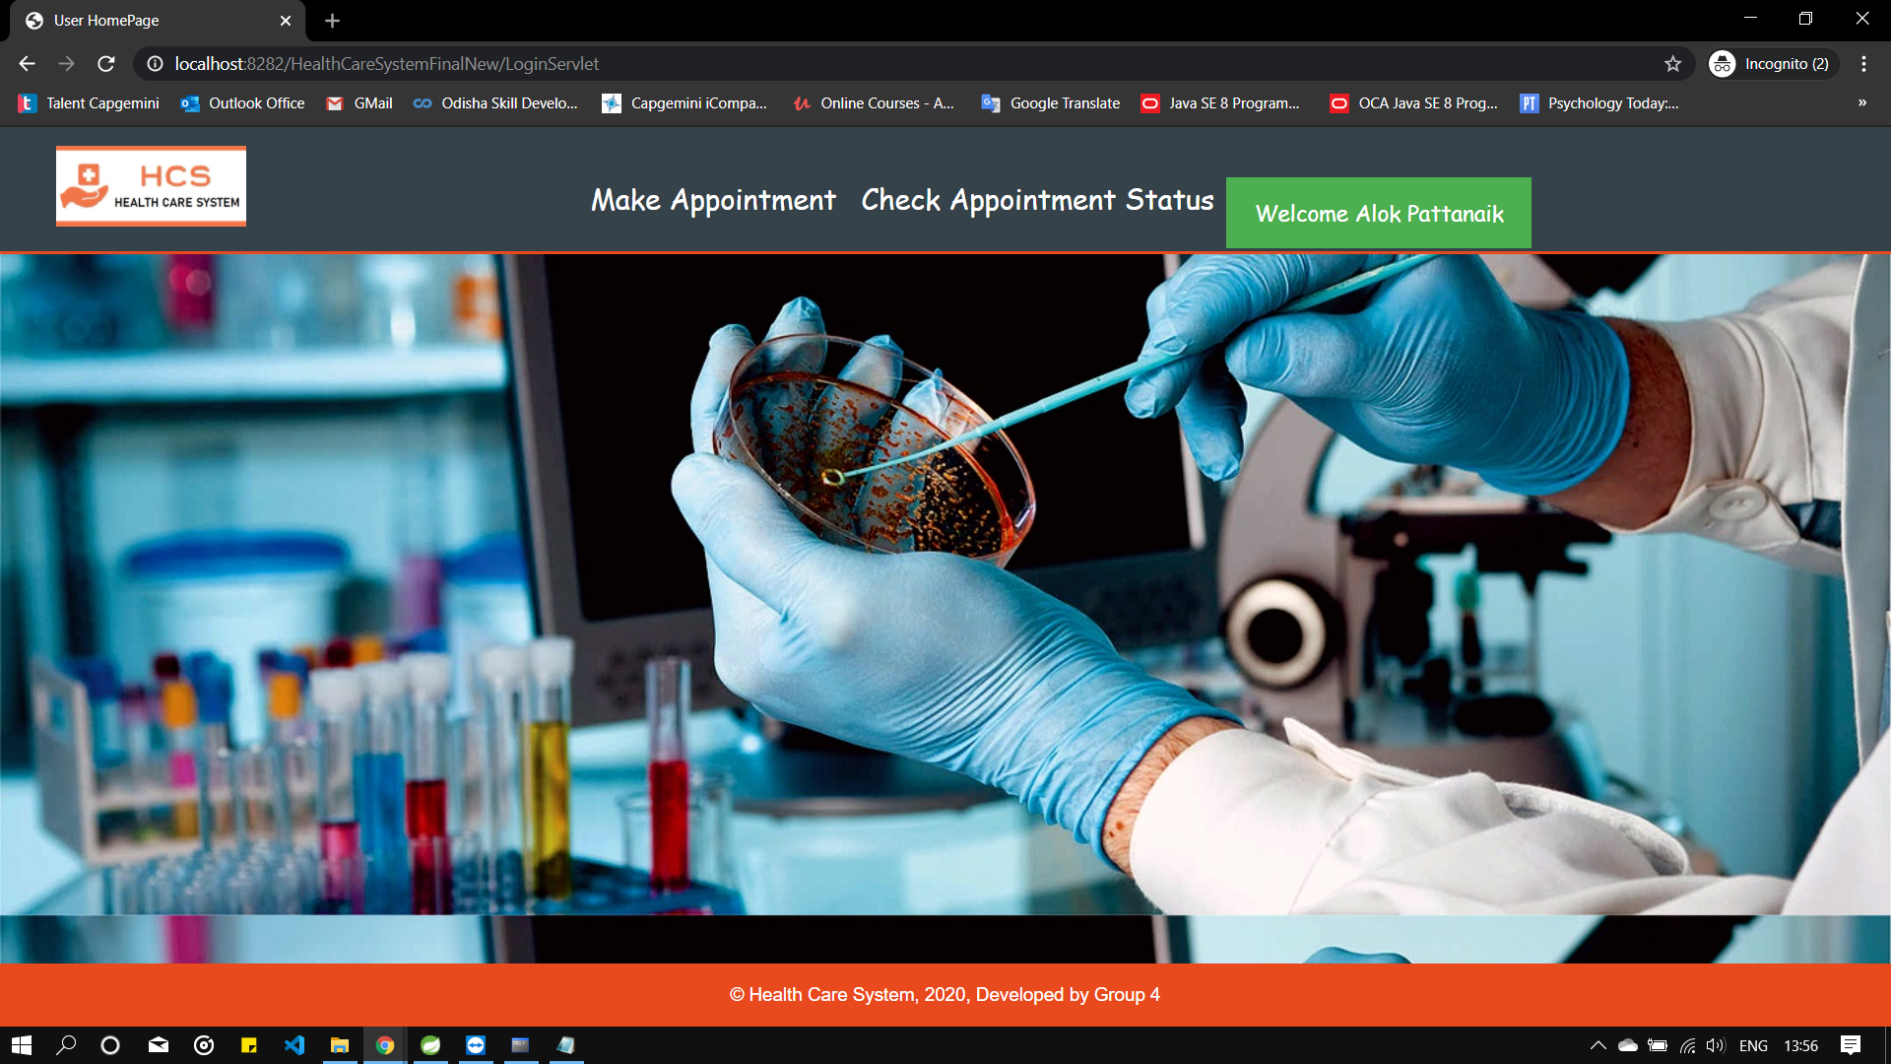

Slide 30
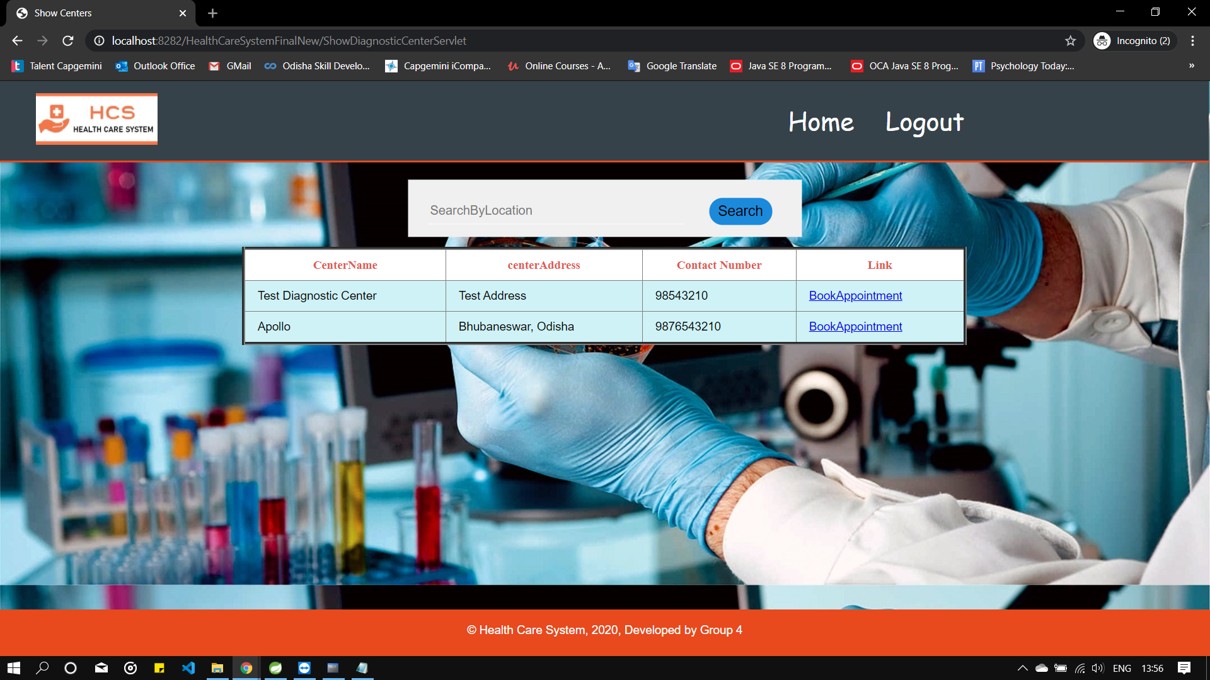

Slide 31
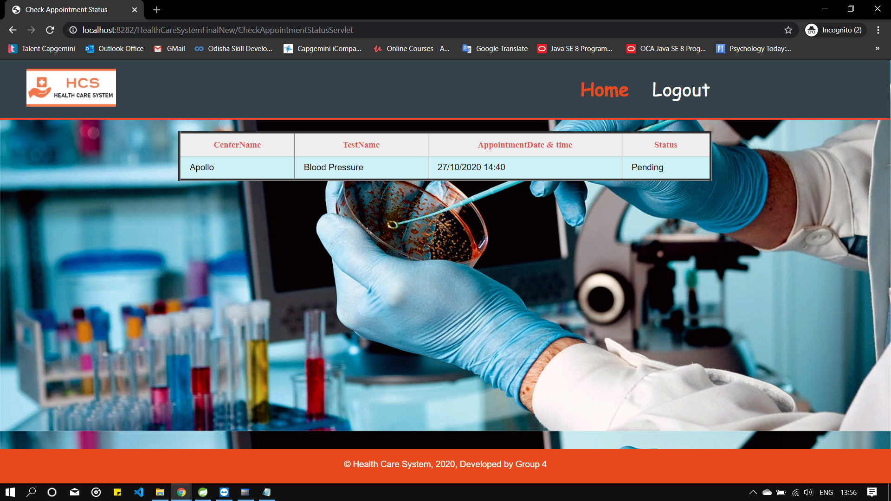

Slide 32
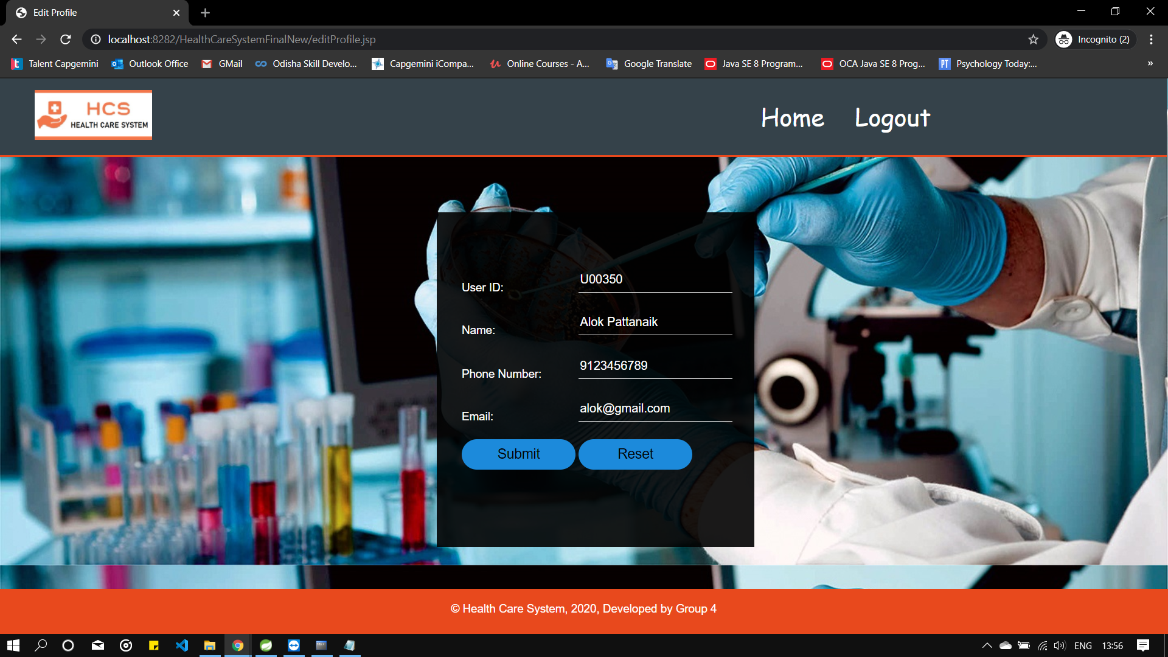

Slide 33
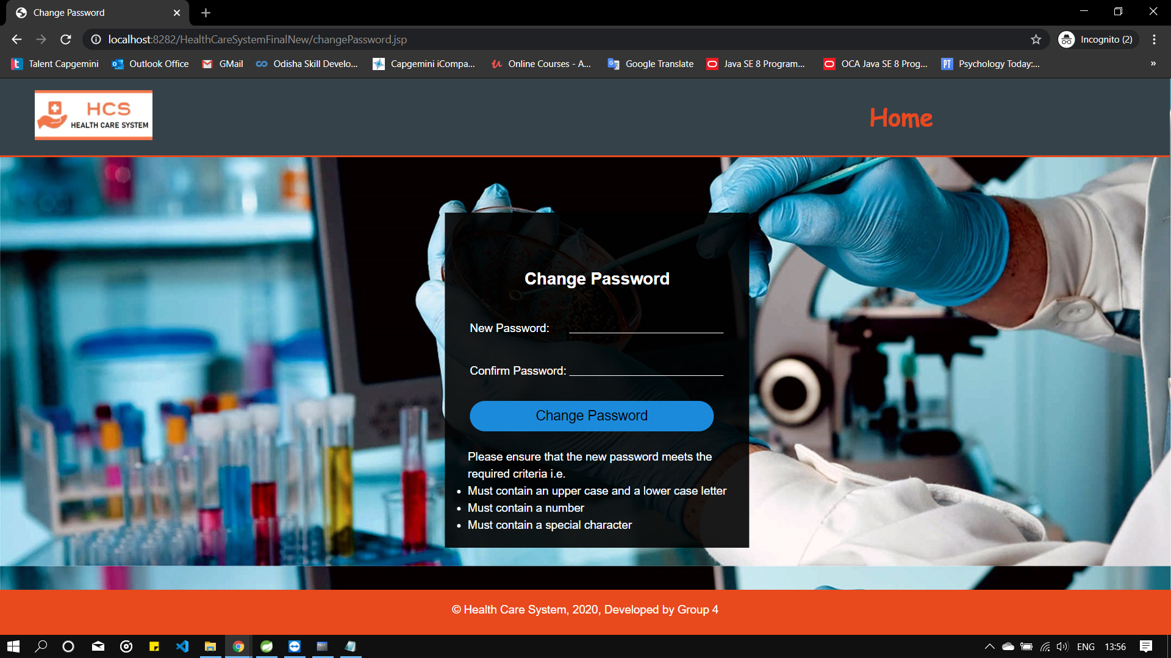

Slide 34
Learning
We have implemented the Health Care System project, using MVC architecture with JPA.
We have learned to work as a team.
Time Management and division of work.
Supporting team members in the work.
We have followed the agile methodology.
Learned project collaboration among team using Git.

Slide 35
Best Practices
Giving documentation for important methods and classes.
Used appropriate naming conventions.
Used proper indentation.
Applied loggers and sessions.
Writing appropriate test cases.

Slide 36
THANK YOU!

